Slide 1

Using SQL Server to Query Active Directory
Wednesday March 18, 2015
Olympia, WA
Presented by
Zap Riecken
Notes:
Stand still. Hello all, my name is Zap Riecken… inflection down. Welcome and thank you for having me
You know that point when…
meeting - apparent - project - AD, don’t care, zone out. Career - multitude - change
Today I’m going to… I solved - give you

Slide 2





What’s in a name…
Zap Riecken
Notes:
1999 Vegas – Startup IT Director – Ever Played slots
Wynn
MGM Mirage Group International – Travel marriage family Oly
Red Wind then on to WSECU – Help use my powers for good

Slide 3





Who is this…
Zap Riecken
Notes:
WSECU Teal – Mudder Orange
Board game collector – 500+ games, own game room, 300+ plays a year, don’t win, in fact wife
Speaking of wife, most amazing thing I own

Slide 4
Agenda
Lesson 1: I am not the smartest man in the room
Lesson 2: How to setup a connection from SQL to Active Directory
Lesson 3: Now to get data out
Lesson 4: What data is available

Slide 5
Lesson 1: Still not the smartest man in the room
Notes:
Sigh…

Slide 6
Lesson 2: Setup a connection from SQL to AD
Pre-requisites
Service Account/User with read access rights to Active Directory (AD)
The ability to connect from your SQL server to your AD boxes
Directory System Agent by default TCP is port 389
Global Catalog is available by default on port 3268
Sufficient privileges in SQL to create a linked server
Notes:
Lesson descriptions should be brief.

Slide 7
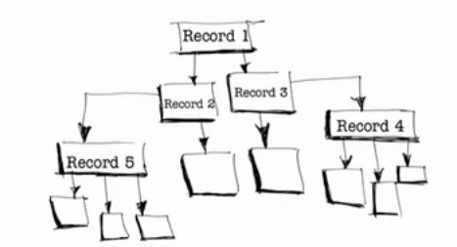
Lesson 2: Setup a connection from SQL to AD
What is LDAP
Lightweight Directory Access Protocol
Designed specifically to provide a hierarchical set of records
Precursor designed by International Telecommunication Union
X.500 turned into LDAP in order to support TCI/IP
It really is a database
Notes:
Seems like all tech storys start, “So back in the 80s”

Slide 8
Lesson 2: Setup a connection from SQL to AD
Creating the linked server
Via TSQL script:
--Create a Linked Server
EXEC master.dbo.sp_addlinkedserver
@server = N'ADSI',
@srvproduct = N'Active Directory Service Interfaces',
@provider = N'ADSDSOObject',
@datasrc = N'adsdatasource'
--Create a security context
EXEC master.dbo.sp_addlinkedsrvlogin
@rmtsrvname = N'ADSI',
@useself = N'False',
@locallogin = NULL,
@rmtuser = N'<DOMAIN>\<username>',
@rmtpassword = '<password>'
Notes:
Useself – impersonation

Slide 9
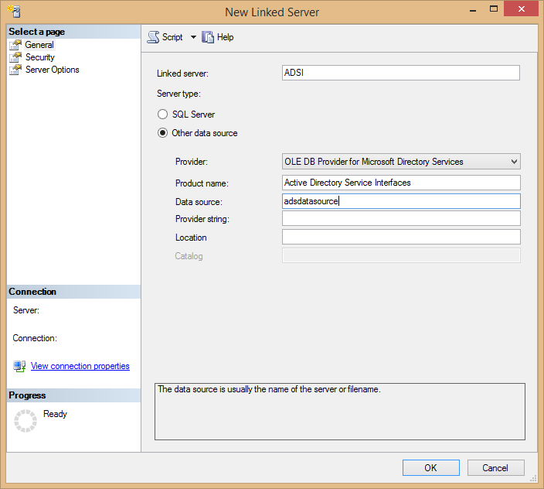
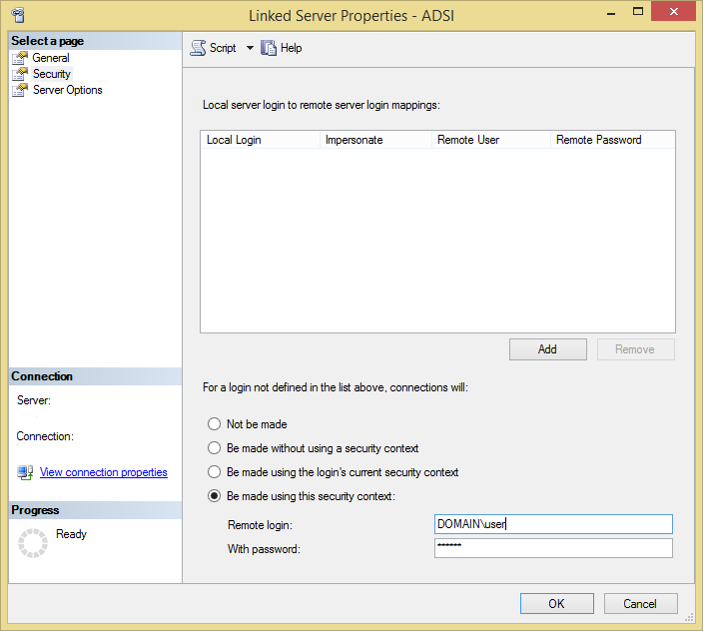
Lesson 2: Setup a connection from SQL to AD
Creating the linked server
Via SQL GUI:
Notes:
Lesson descriptions should be brief.

Slide 10
Lesson 3: Now to get data out
OpenRowset
Requires allowing Ad Hoc Distributed Queries
The connection string is passed as clear text, including username and password
Limited functionality compared to OpenQuery
BUT you don’t need a linked server
Notes:
-The OPENROWSET function allows access to a remote data source through Ad Hoc – Very common method for SQL Injection
-There is a secure LDAP

Slide 11
Lesson 3: Now to get data out
OpenQuery
Using LDAP Dialect:
SELECT
SAMAccountName,
givenName,
sn
FROM OPENQUERY(ADSI,
'<LDAP://OU=SubOrgUnit,OU=OrgUnit,DC=Domain,DC=Suffix>;
(&(objectCategory=Person));
SAMAccountName,givenName, sn;
subtree')
This is your linked server name
This is your LDAP connection string
This is your filter criteria
These are the columns you want returned
This defines the scope of your returned results
Notes:
Two different dialects to choose from.

Slide 12
Lesson 3: Now to get data out
OpenQuery
Using SQL:
SELECT
SAMAccountName,
givenName,
Sn
FROM OPENQUERY(ADSI,
'SELECT SAMAccountName,givenName,sn
FROM ''LDAP://OU=<SubOrgUnit>,OU=<OrgUnit>,DC=<DOMAIN>,DC=<COM>''
WHERE objectCategory = ''Person''
')
This is your linked server name
These are the columns you want returned
This is your LDAP connection string
This is your filter criteria
Msg 7321, Level 16, State 2, Line 1 An error occurred while preparing the query
Notes:
Lesson descriptions should be brief.

Slide 13
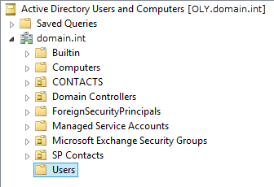
Lesson 3: Now to get data out
OpenQuery
LDAP Connection String:
LDAP://
OU=Users
, DC=domain
, DC=int
Notes:
Lesson descriptions should be brief.

Slide 14
Lesson 3: Now to get data out
OpenQuery
NEW LDAP Connection String:
SELECT
SAMAccountName,
givenName,
Sn
FROM OPENQUERY(ADSI,
'SELECT SAMAccountName,givenName,sn
FROM ''LDAP://OU=Users,DC=domain,DC=int''
WHERE objectCategory = ''Person''
')
Msg 7330, Level 16, State 2, Line 1 Cannot fetch a row from OLE DB provider "ADSDSOObject" for linked server “ADSI".
Notes:
Lesson descriptions should be brief.

Slide 15
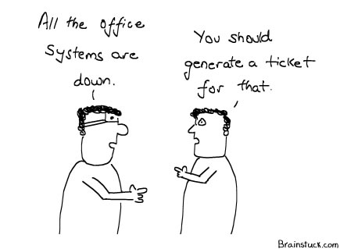
Lesson 3: Now to get data out
OpenQuery
Limitations on OpenQuery:
Active Directory is configured by default to have a MaxPageSize of 1000 records.
In SQL 2000-2005 you get 1000 rows and in SQL 2008+ you get 901 rows before it breaks.
Go to AD Admin and have them increase the value for MaxPageSize.
Fix it YOURSELF!
I went back and modified my query to paginate based on easy variables – like the first alpha character from the users’ name.
Notes:
Lesson descriptions should be brief.

Slide 16
Lesson 3: Now to get data out
OpenQuery
Paginated Query:
IF OBJECT_ID('tempdb.dbo.#tmpADUsers') IS NOT NULL
DROP TABLE #tmpADUsers
CREATE TABLE #tmpADUsers (
SAMAccountName VARCHAR(255) NULL,
givenName VARCHAR(255) NULL,
sn VARCHAR(255) NULL
)
GO
DECLARE @cmdstr VARCHAR(255)
DECLARE @nAsciiValue SMALLINT
DECLARE @sChar CHAR(1)
SET @nAsciiValue = 65
WHILE @nAsciiValue < 91
BEGIN
SET @sChar = CHAR(@nAsciiValue)
EXEC master.dbo.xp_sprintf @cmdstr OUTPUT,
'SELECT SAMAccountName,givenName,sn
FROM OPENQUERY( ADSI,
''SELECT SAMAccountName,givenName,sn
FROM ''''LDAP://OU=Users,DC=domain,DC=int''
''WHERE objectCategory = ''''Person''''
AND SAMAccountName = ''''%s*'''''' )',
@sChar
INSERT #tmpADUsers
EXEC (@cmdstr)
SELECT @nAsciiValue = @nAsciiValue + 1
END
SELECT *
FROM #tmpADUsers
DROP TABLE #tmpADUsers
Notes:
Who can tell me the ASCII for 65?
SET @sChar – Don’t judge me…
Limitation

Slide 17
Lesson 3: Now to get data out
OpenQuery
NEW Paginated Query:
--First we build the Query
DECLARE @selectQuery VARCHAR(MAX) = '
SELECT * FROM OPENQUERY(ADSI, ''
SELECT samAccountName,
telephoneNumber,
mail,
givenName,
sn,
displayName
FROM ''''LDAP://OU=Users,OU=WSECU,DC=wsecu,DC=int'''‘
WHERE objectCategory = ''''Person''''
AND samAccountName = ''''@s'''''')';
Notes:
Lesson descriptions should be brief.

Slide 18
Lesson 3: Now to get data out
OpenQuery
NEW Paginated Query – Part 2:
--Now lets make SQL do the heavy lifting
DECLARE @sql VARCHAR(MAX) = 'CREATE VIEW [ADView] AS ';
DECLARE @asciiValue INT = ASCII('A');
DECLARE @asciiEnd INT = ASCII('Z');
WHILE @asciiValue <= @asciiEnd
BEGIN
SET @sql = @sql + replace(@selectQuery, '@s', CHAR(@asciiValue) + '*');
IF @asciiValue < @asciiEnd
SET @sql = @sql + ' UNION ALL ';
SET @asciiValue = @asciiValue + 1;
END
Notes:
Lesson descriptions should be brief.

Slide 19
Lesson 3: Now to get data out
OpenQuery
NEW Paginated Query – Part 3:
--Check to see if the view is already there
IF OBJECT_ID('[ADView]') IS NOT NULL
DROP VIEW [ADView]
--Create the view
EXEC (@sql);
--View the data
SELECT *
FROM [ADview]
WHERE samAccountName = 'zapr'
Notes:
Lesson descriptions should be brief.

Slide 20
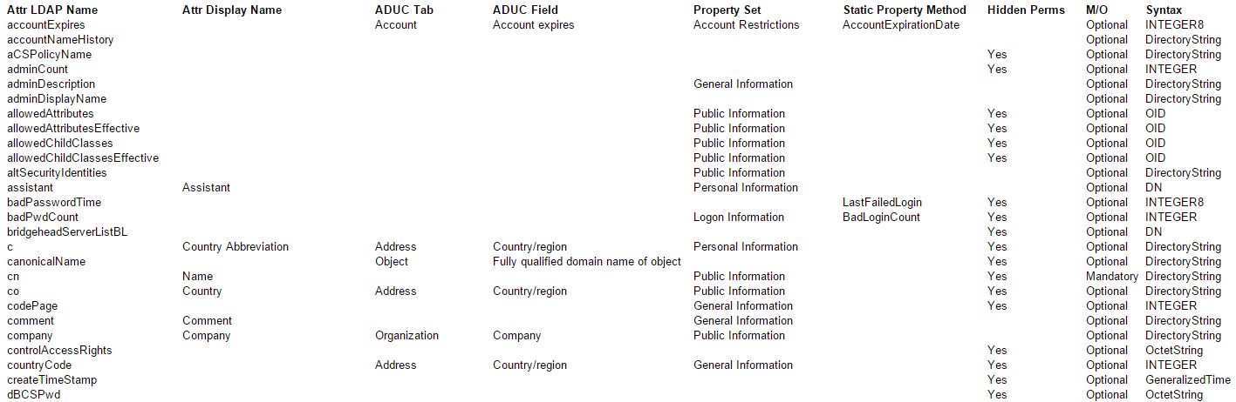
Lesson 4: What data is available
User Attributes
Notes:
Lesson descriptions should be brief.

Slide 21

Lesson 4: What data is available
User Attributes
With 200+ columns to choose from this little data connection is a lot bigger on the inside than we can see from here.
Inside Active Directory A book by Sakari Kouti and Mika Seitsonen
Reference tables for user class attributes http://www.kouti.com/tables/userattributes.htm
Note: this was last updated in 2001
Notes:
AD seems like this nice little hierarchical data source

Slide 22
Lesson 4: What data is available
Useful fields
Unique ID
SID vs GUID
SID is specific and unique to the user where they are in AD
GUID is specific unique to the user regardless of where they are
A SID will change if the user is moved (domain to domain – not OU)
GUID will remain with the user forever
objectSid | objectGUID | SAMAccountName | givenName | sn
0x01050000000000021200000024111672862D1157B402BA43CC520000 | 0xFDAFA43805E1C14E89B1FFC32D32DCE2 | ZapR | Zap | Riecken
Notes:
Lesson descriptions should be brief.

Slide 23
Lesson 4: What data is available
Useful fields
Account Disabled
userAccountControl
0000000000000000000000000000000x | 1 | Reserved, the value must always be 0
00000000000000000000000000000010 | 2 | UF_ACCOUNT_DISABLE
00000000000000000000000000000x00 | 4 | Reserved, the value must always be 0
00000000000000000000000000001000 | 8 | UF_HOMEDIR_REQUIRED
00000000000000000000000000010000 | 16 | UF_LOCKOUT
00000000000000000000000000100000 | 32 | UF_PASSWD_NOTREQD
00000000000000000000000001000000 | 64 | UF_PASSWD_CANT_CHANGE
00000000000000000000000010000000 | 128 | UF_ENCRYPTED_TEXT_PASSWORD_ALLOWED
00000000000000000000000x00000000 | 256 | Reserved, the value must always be 0
00000000000000000000001000000000 | 512 | UF_NORMAL_ACCOUNT
Notes:
Lesson descriptions should be brief.

Slide 24
Lesson 4: What data is available
Gotchas
Remember users can be stored in different OUs
Cannot query for multi-valued attributes like Member Of
LDAP is case-sensitive
AD also has a MaxResultSize value set to 256KB (approx. 262,144 characters)
Notes:
Lesson descriptions should be brief.

Slide 25
Thank you
For attending this session on Using SQL Server to Query Active Directory
Contact me:
zap@therieckens.com
@CinfulGentleman – board gaming tweets
@CinfulSQL – SQL tweets
Questions?

Slide 26
Additional Resources
Querying Active Directory through SQL Server Using OpenRowset and OpenQuery by Nicki Kowalchuk http://www.skylinetechnologies.com/Blog/Article/1309/Querying-Active-Directory-through-SQL-Server-Using-OpenRowset-and-OpenQuery.aspx
SQL SERVER – Use of xp_sprintf – System Stored Procedure by Ayyappan Thangaraj https://sqlserverrider.wordpress.com/2013/07/31/sql-server-use-of-xp_sprintf-system-stored-procedure/
Querying Active Directory on SQL Server using T-SQL by Pavel Pawlowski
http://www.pawlowski.cz/tag/ldap/
Attributes for AD Users: userAccountControl
by Philipp Foeckeler
http://www.selfadsi.org/ads-attributes/user-userAccountControl.htm

